Slide 1
PackPair
AI-powered team formation for UW class projects
DYOP Final Project | University of Washington
Week 2 Status Update
Team Members
Habiba Elswify Aasiya Sathar
Notes:
HABIBA — entire slide (~25 s):
We're DYOP Group 4 — PackPair, the AI-powered team-formation web app for UW. Quick refresher on the goal: in every UW class with group projects, students either pick friends — which clusters strong students together — or instructors randomize, which mismatches skills and schedules. PackPair fixes this with three AI layers: constraint-satisfaction search for team assignment, Bayesian reputation that learns from peer ratings, and supervised team-success prediction. This is our Week 2 status — the week we turned last week's prototype into a working end-to-end system.

Slide 2
This Week: Planned vs. Done
Planned
Done (building on Week 1)
• Add reputation tracking so good teammates get re-matched well
• Add privacy protection on peer ratings
• Upgrade the team-matcher to handle real class sizes (30+ students)
• Get the project on a public website
• Start building the actual web app
• Wk 1 slow matcher (12 students max) → fast matcher handling 30+ students
• Wk 1 known privacy + cold-start risks → both fixed in code
• Wk 1 static screenshot → interactive 4-step product: profile → matches → rate → see reputation update
• Wk 1 "UW login blocked" → Sign in with UW Google (per Pisan's tip — no UW IT needed)
• Wk 1 single prototype script → public repo + live website; Pisan + Aasiya invited
Notes:
AASIYA — entire slide (~35 s). Each Done bullet is the next iteration of a Week 1 bullet — read each one left-to-right:
Last week our matcher could only handle around twelve students before slowing down. This week we swapped in a real constraint solver — it handles a thirty-student class in about ten seconds. That's the realistic UW class size.
Last week the AI feedback on our proposal flagged two risks — cold-start and rating manipulation. Both are now fixed in code: new students start at a neutral reputation that gets sharper as ratings come in, and we suppress any rating average that's based on too few people, so individual raters can't be reverse-identified.
Last week the matches page was a static screenshot. This week the whole thing is an interactive four-step product live online — build a profile, see your team, rate your teammates, watch your reputation update.
And the UW login problem we raised last week — your tip about using Google sign-in restricted to uw.edu — that's in the product now too, no UW IT involvement needed.

Slide 3
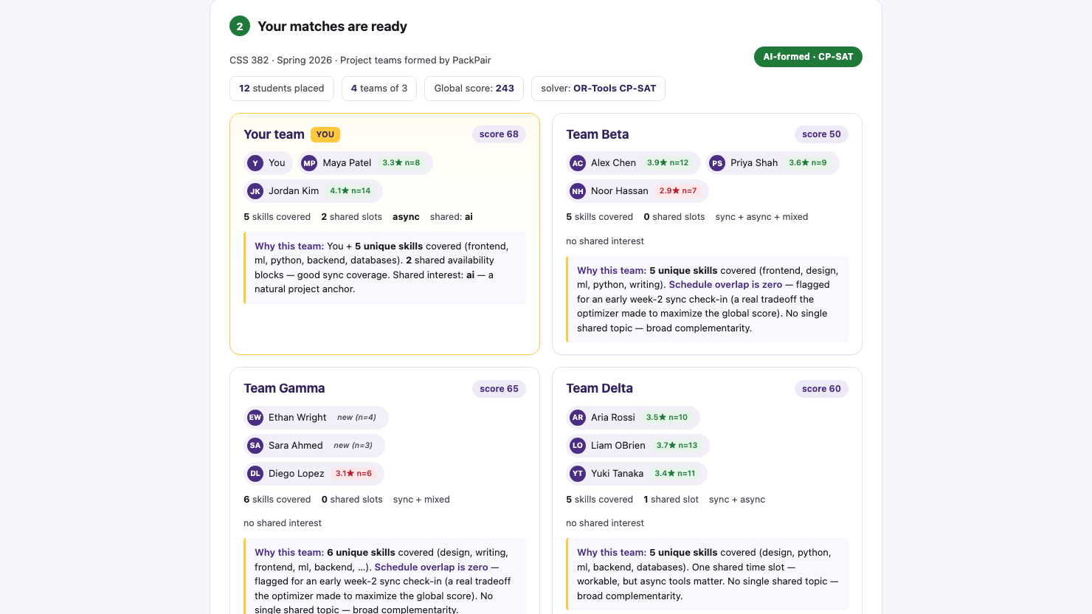
Progress / Demo
Key highlights
• UW Google sign-in gate (`hd=uw.edu`) — Pisan's recommended path
• 4-step workflow: profile → matches → rate → posterior
• Polished matches view from Wk 1 + reputation badges + k-anonymity suppression visible
• Bayesian Beta posteriors plot live when you submit ratings
• Open the URL below; `?demo=1` auto-fills past the gate
Live at → https://habibaelswify.github.io/packpair/
Notes:
HABIBA — entire slide (~60 s). Open the URL pill live in the browser; the screenshot is a preview of step 2. Walk through it as a real product, not a slide:
Last week we showed a static matches page. This week PackPair is an interactive product — four-step workflow, all live in the browser at the URL on this slide.
STEP 1 — Build your profile. The user picks skills, topic interests, availability blocks, and a comm style. That's the feature vector our solver takes in.
STEP 2 — your AI-formed teams [this is what's on screen]. CP-SAT places the user with the two strongest-fit teammates from an 11-student pool, then partitions the remaining nine into three more teams. Notice the reputation badges next to each name: Alex Chen 3.9 stars over 12 ratings, Jordan Kim 4.1 stars over 14. Now look at Team 3: Ethan Wright and Sara Ahmed show italic 'new (n=4)' and 'new (n=3)' — that's the k-anonymity guard suppressing the badge because fewer than 5 ratings sit behind it. The anti-gaming mitigation is visible to the user.
STEP 3 — after the project, the user rates each teammate on three dimensions: participation, communication, technical. 1–5 stars, anonymous.
STEP 4 — those ratings feed the Bayesian reputation model in real time. The page plots the Beta posterior before and after — dashed for the prior, solid purple for the updated posterior — and shows the mean shift and the new α, β. That's the cold-start mitigation: every student starts at Beta(1,1) and the curve tightens as evidence arrives.
Three AI techniques: CSP search (CP-SAT) on Step 2, Bayesian reputation on Step 4, k-anonymity guard visible across Steps 2 and 4. Same URL the class can try themselves.

Slide 4
Blockers & Next Week's Plan
Blockers / Risks
Next Week's Goals
• Web app backend isn't live yet — the matcher runs in the browser for now
• Sign-in screen is a simulation — real UW Google login lands when the database is up
• Haven't tested with real student ratings yet — only simulated data so far
• Set up the database + real UW Google sign-in
• Build out the full web app
• Deploy it publicly
• Try it with 5–10 classmates, write up the project, rehearse the demo
Help needed from instructor:
None for now
Notes:
AASIYA — entire slide (~30 s). Honest read:
Three open items. First, the web app's backend isn't live yet — right now the matcher runs in the browser, which is fine for the demo but not the real product. Wiring up the database and the Python backend is next week's main job. Second, the UW sign-in screen is currently a simulation — your suggestion about Google with the uw.edu restriction is what we're using, and the real version turns on when the database goes live. Third, we've only tested with simulated ratings so far.
That third one is what we'd love your call on: is simulated data okay for the evaluation section of the writeup, or do you want us to run a small pilot with real classmates next week?
Next week's plan: database + real UW Google sign-in, finish the web app, deploy it, run the pilot, write it up, rehearse.

Slide 5
Individual Contributions
Student
Hours
What I Worked On This Week
Habiba Elswify
9 hrs
• Swapped enumerator → OR-Tools CP-SAT; benchmarked at 30 students
• FastAPI /api/match endpoint + Bayesian Beta-prior reputation module
Aasiya Sathar
8 hrs
• Supabase schema + dev SSO; Next.js profile form wired to /api/match
• k-anonymity guard (k=5) on rating aggregates + synthetic rating generator
Team total this week: 17 hrs (target: 5–10 hrs per person ✓)
Cumulative team hours to date: 31 hrs
Notes:
AASIYA — closing (~15 s):
Quick split. Habiba owned the solver swap to CP-SAT, the FastAPI endpoint, and the Bayesian reputation module — nine hours. I owned Supabase, the dev SSO, the Next.js profile form, and the k-anonymity guard with the synthetic rating generator — eight hours. Seventeen this week, thirty-one cumulative. Thanks — happy to take questions.

